Slide 1

Development Best Practices
Vishal INGLE

Slide 2

Vishal INGLE
Technology Analyst @ Airbus Group India Pvt. Ltd.
3+ years on ServiceNow platform as Developer and BA.
Certified System Administrator
CIS– Application Portfolio Management
CIS– Project Portfolio Management
Like cooking, writing & wildlife photography.
Worked as a teacher and authored three books.

Slide 3


Slide 4
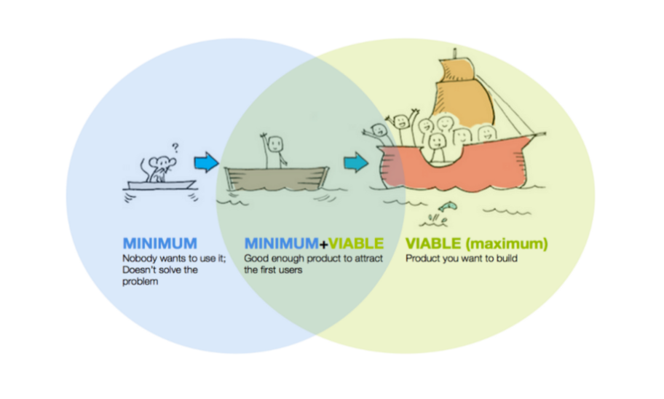

Slide 5
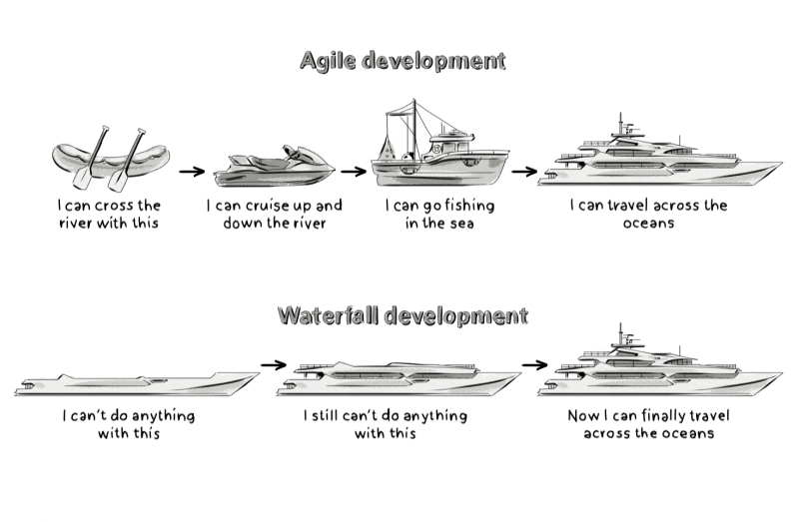
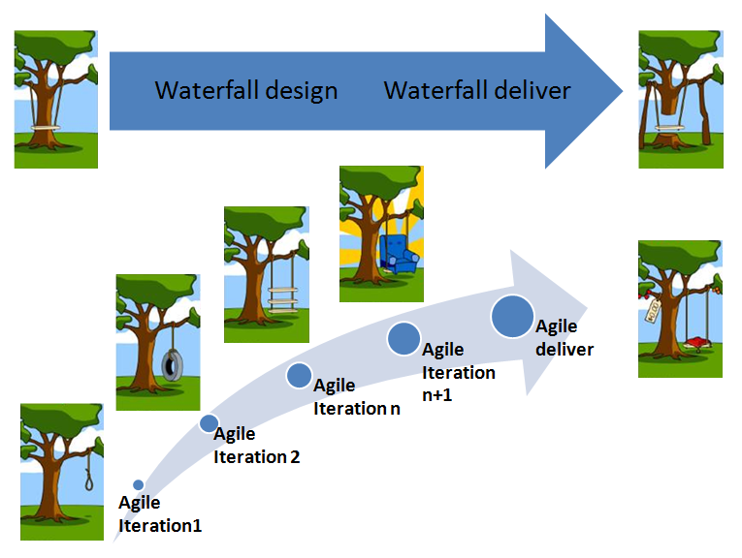

Slide 6
Code in Stages
Do not attempt to write hundreds of lines of code in one sitting.
Write a few lines of code at a time and test as you go to ensure it works as expected.
If you try to write too much code at one time, it becomes difficult to locate the source of a problem.
Instead of tracking back through lines and lines of code to find the defect, save time and effort by incrementally writing functional code.

Slide 8

Pair/Mob/Group programming
Two or more people working on the same codebase (often using one computer/shared screen)
Synchronous and shared/group coding
Driver “types” + Navigator “talks” + Mobber “researches”
Dev + Ops (E.g. DBA) + Business (e.g. PO)
Collaboration
Brainstorming
Specially useful while bug fixing

Slide 9

Pair/Mob /Group programming
Find common time slot
Start with the camera on
Five-minute chat before your start
Agree on goal
Communicate
Acknowledge the level of differences

Slide 11
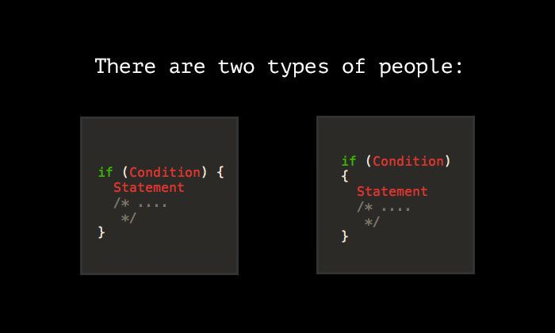

Slide 12
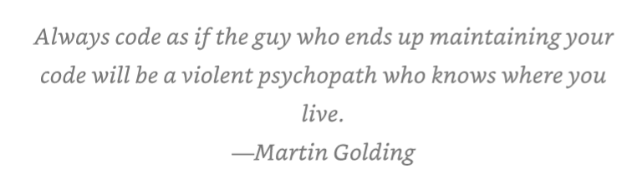
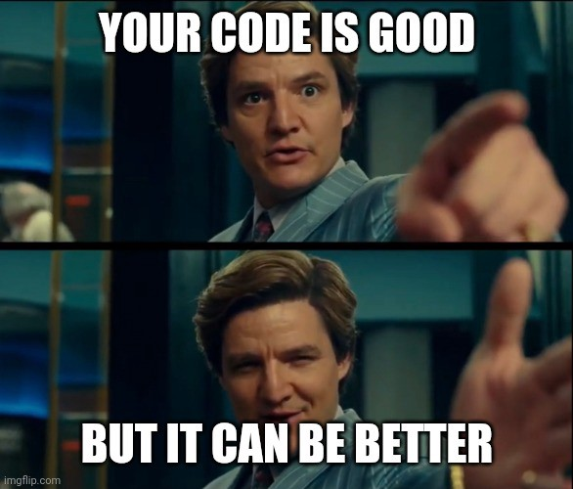
Code is for Humans
Code might be written only once, but it gets read many times.
If you don’t know why your code works, you have no hope of fixing it when it breaks, other than sheer luck and guessing and magic.
When people say that code is so hard to understand that it’d be faster if I just rewrote it, what they’re really saying is the code doesn’t communicate its ideas.

Slide 13
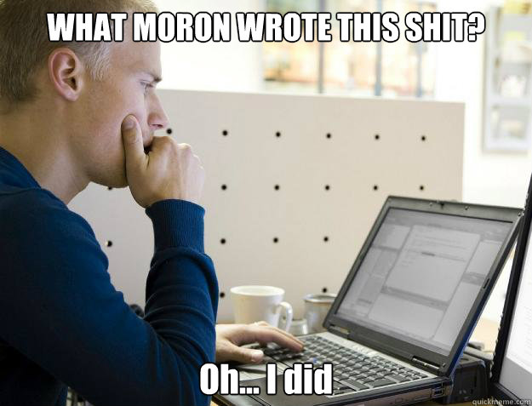
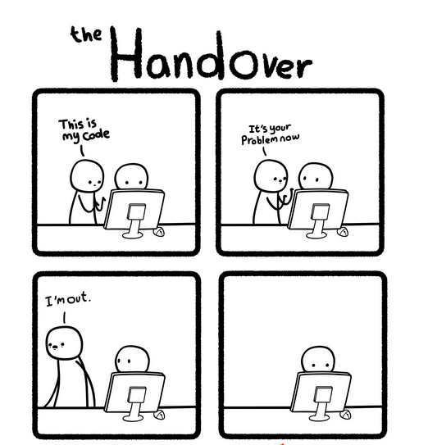

Slide 14
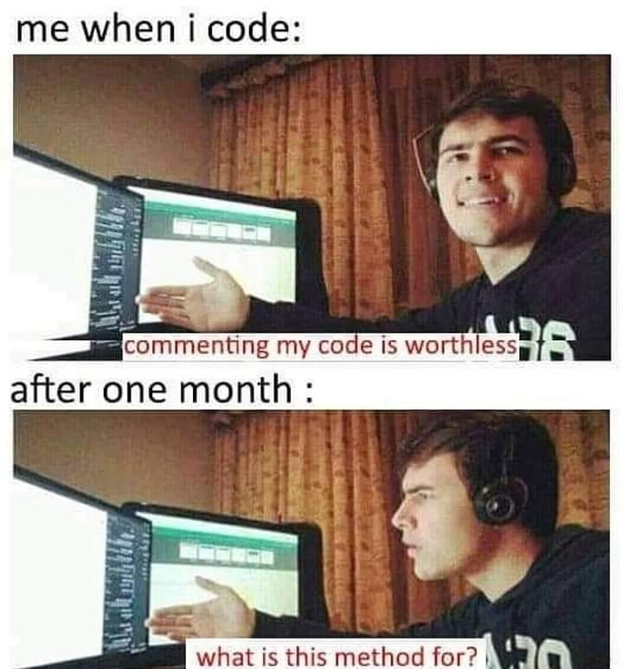


Slide 15
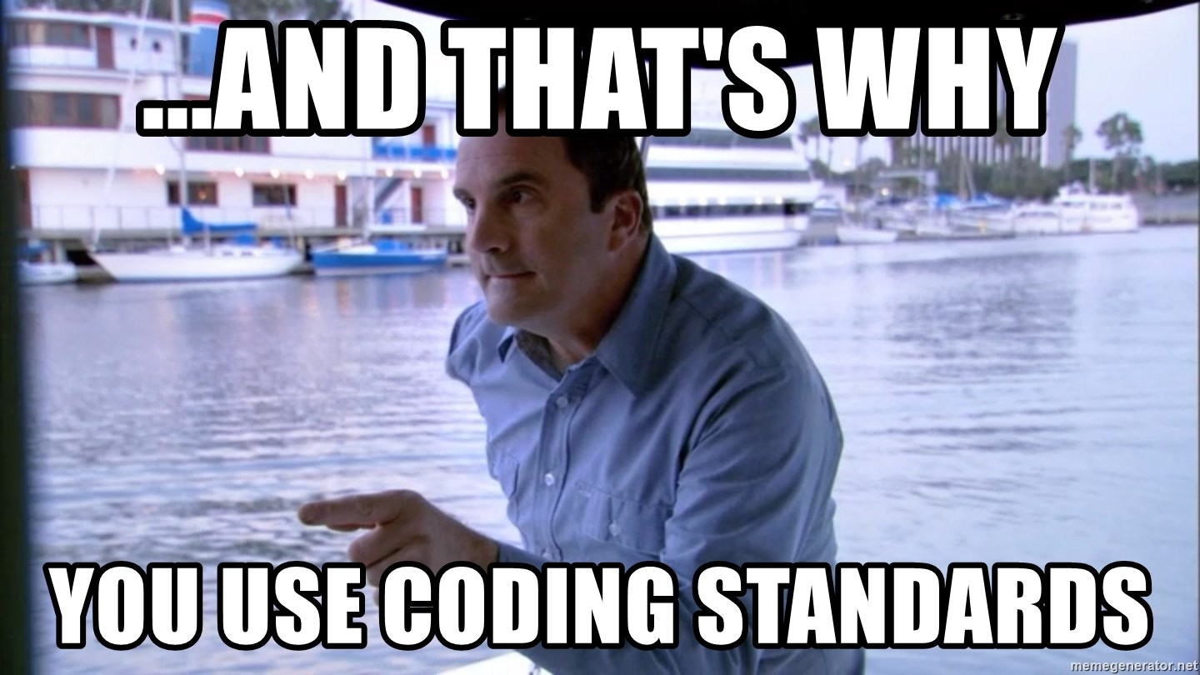

Slide 16
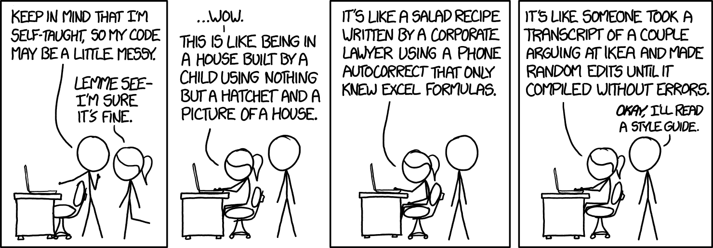
Style guide

Slide 17
Style guide
A style guide or manual of style is a set of standards for the writing, formatting, and design of documents.
A style guide establishes standard style requirements to improve communication by ensuring consistency both within a document, and across multiple documents.
A style guide tells a developer how to work with a particular programming language.
Programming style guides are composed of rules and guidance, such as acceptable naming conventions.

Slide 18
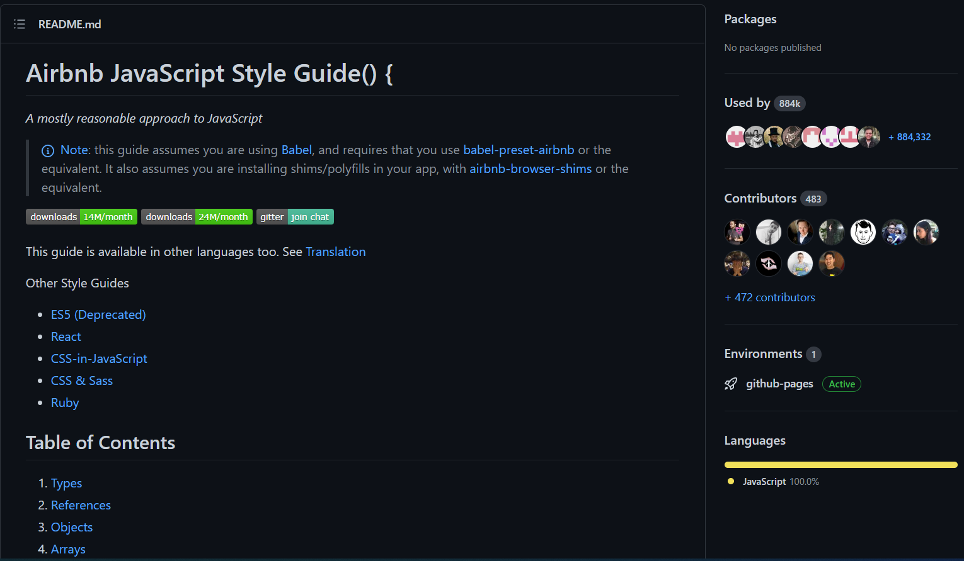
Style guide https://github.com/airbnb/javascript

Slide 19
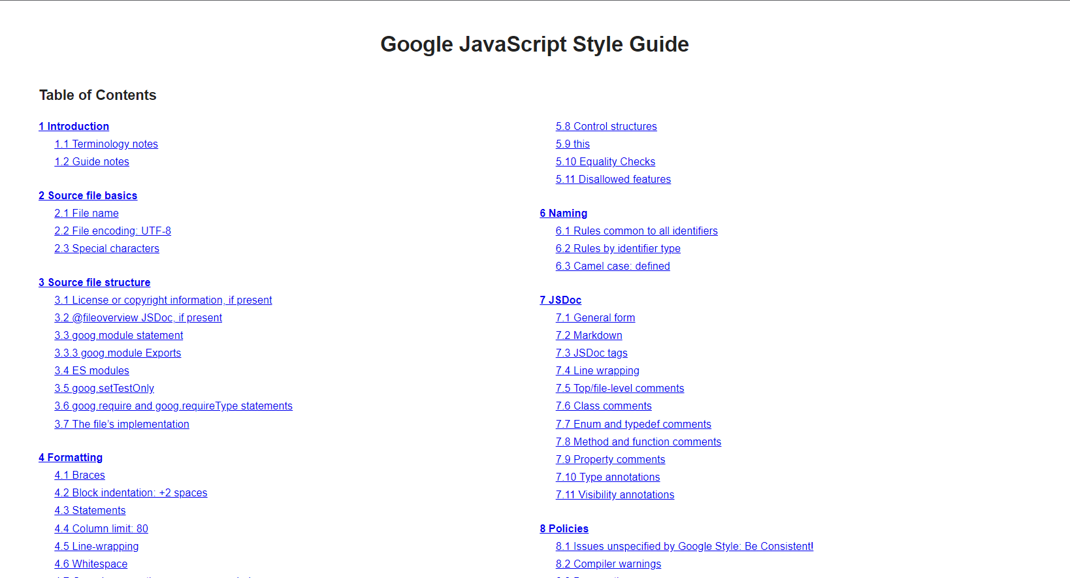
Style guide https://google.github.io/styleguide/jsguide.html

Slide 20
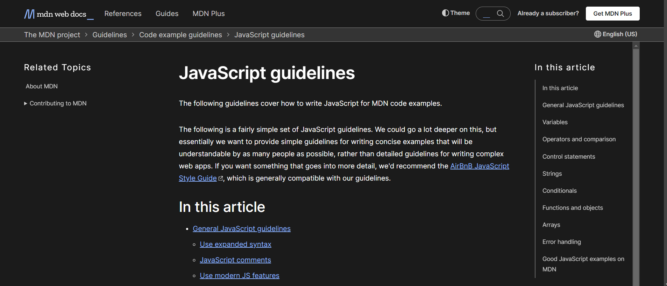
Style guide https://developer.mozilla.org/en-US/docs/MDN/Guidelines/Code_guidelines/JavaScript

Slide 21
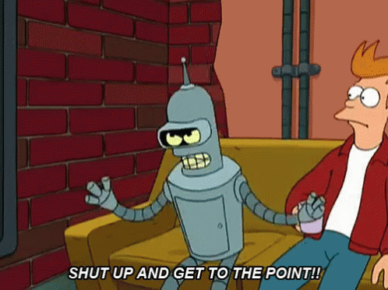

Slide 22
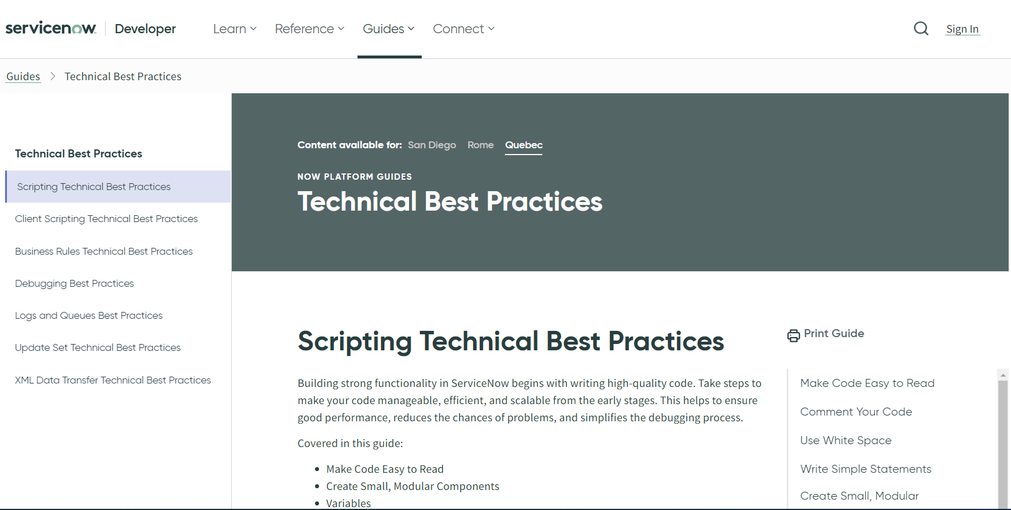
ServiceNow Best Practices https://developer.servicenow.com/dev.do#!/guides/quebec/now-platform/tpb-guide/scripting_technical_best_practices

Slide 23
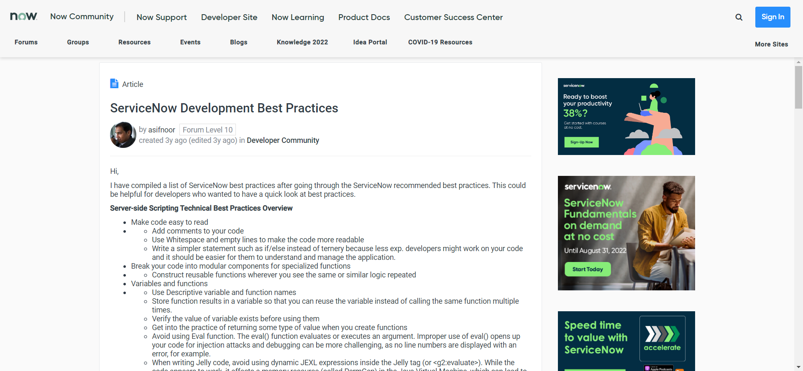
ServiceNow Best Practices https://community.servicenow.com/community?id=community_article&sys_id=5c384744dbf0b34414d6fb243996190f

Slide 24
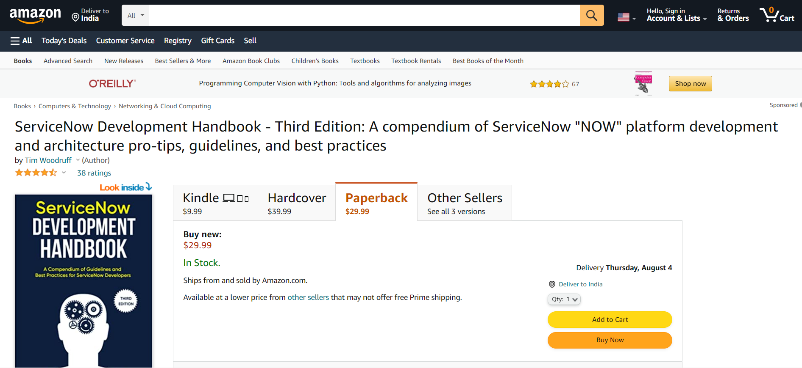
ServiceNow Best Practices https://read.amazon.in/kp/embed?asin=B099K5N4SJ&preview=newtab&linkCode=kpe&ref_=cm_sw_r_kb_dp_N5AMAFF950496AJFFTPS

Slide 25
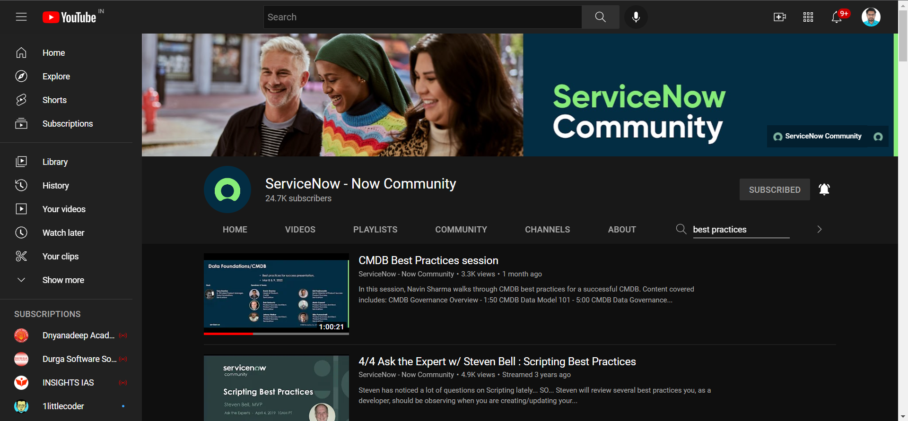
ServiceNow Best Practices https://www.youtube.com/c/ServiceNowCommunity/search?query=best%20practices

Slide 26
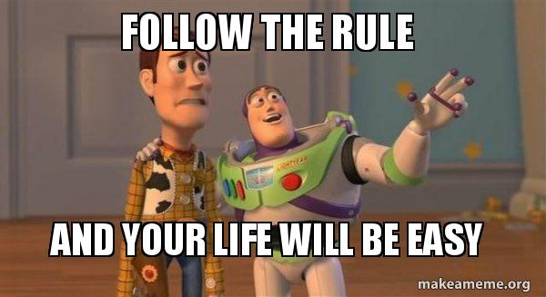

Slide 27
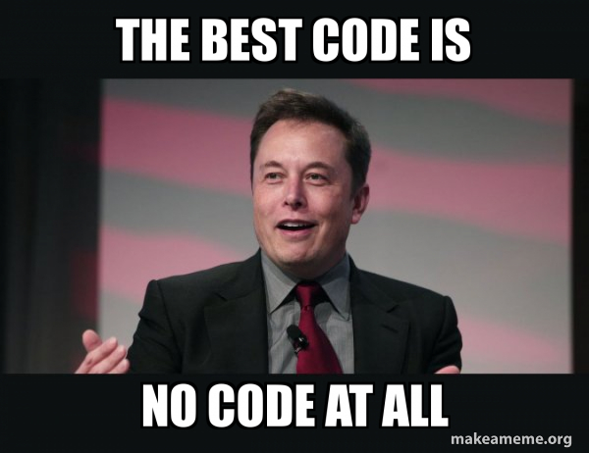
Scripting Best Practices
When writing code, remember that others may work with it in the future.
Whenever possible, ensure your code is easy to read and understand.
Follow any formatting standards used by your organization.
Take steps to make your code manageable, efficient, and scalable from the early stages.
Script only when necessary
UI Policy vs. Client Script
Flow designer

Slide 28

Scripting Best Practices
Follow the organizational naming conventions
Write description for every script you create
Always mention from where the new event is being called while creating event registry
Document it

Slide 29
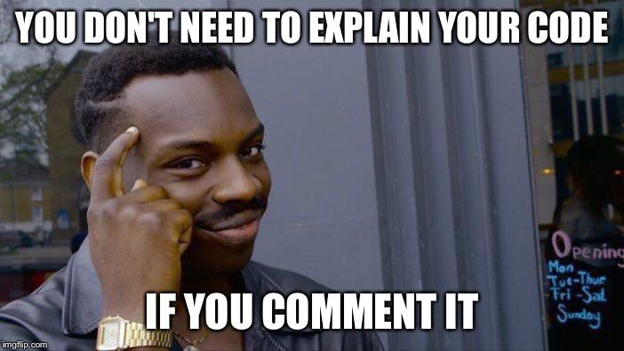
Best Practices for Code Formatting Comment your code
What may seem obvious today may not be clear in the future, especially on a complicated section of code.
Comments should be well-written and clear, just like the code they are annotating.
Write meaningful comments.
Clearly describe the purpose of functions and all inputs and outputs.
Keep comments as accurate as possible.
Also be sure to keep comments up to date as the scripts are updated.
Include leading spaces in comments

Slide 30
Best Practices for Code Formatting Comment your code
Single line comments
// This is Single line comment
Multiline Comments
/*
This is
multiline
comment
*/
Better multiline Comments
/**
* This is
* multiline
* comment
*/
Bad multiline Comments
// This is
// multiline
// comment

Slide 31
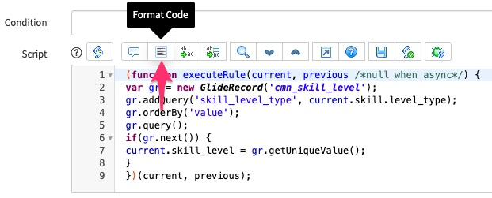
Best Practices for Code Formatting Use White Space
Use empty lines and spaces to make code more readable.
The easier it is to read code, the easier it is to identify and correct issues.
Empty lines help visually group blocks of code together so the reader can see the logical organization.
Spaces on each line help make the items on an individual line easier to read.
The format code button in the ServiceNow syntax editor toolbar is a useful tool for adjusting indentation without altering other spacing.
The lack of indentation and spacing in the previous example makes it difficult to determine the flow of logic.

Slide 32
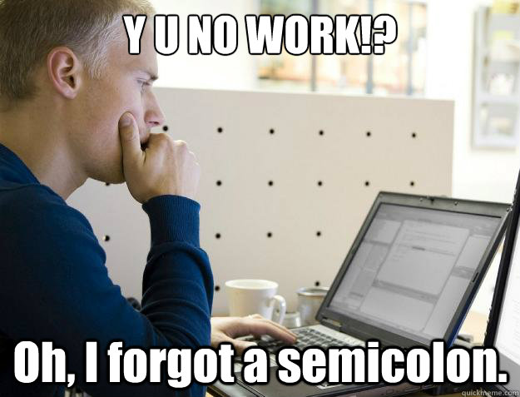
Best Practices for Code Formatting Punctuations - Be consistent!
End statements (which does not end with curly braces) with a semicolon
Standardize line length
Use commas consistently
Indent consistently
Use space before and after operators
Use a consistent format for blocks
Use consistent spacing before function signature parentheses
Space after commas, but not before
Limit blank spaces to one line
Write Simple Statements

Slide 33

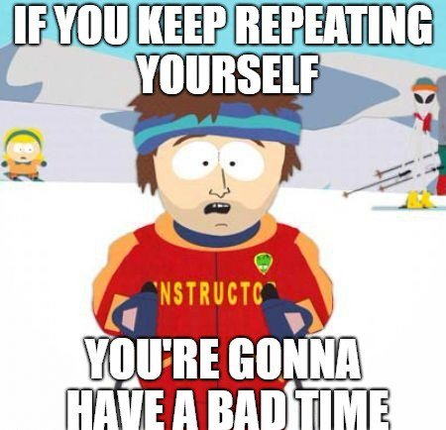
Don’t repeat yourself (DRY)
Every piece of knowledge must have a single, unambiguous, authoritative representation within a system.

Slide 34
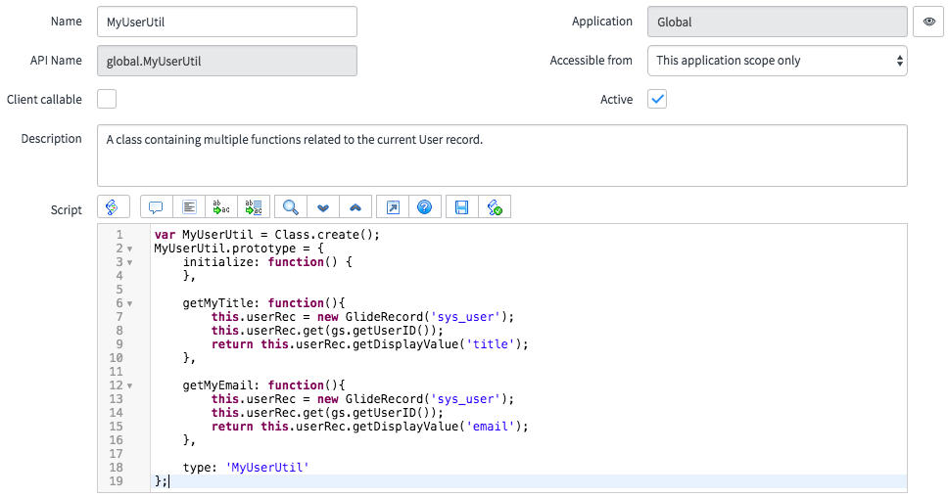
Create Small, Modular Components
Break your code into modular components or specialized functions.
Script Include functions are excellent examples of this technique.
They are easy to create because they are small and simple with limited functionality.
They are generally simpler and shorter, so it is easy to understand the logic, inputs, and outputs.
This makes it easier for the next person who works with the code to make modifications.
They are easier to test.

Slide 35
Create Small, Modular Components
If you see the same or similar logic repeated in a process, consider creating a specialized function.
This improves the quality of code, saves you the trouble of searching through multiple blocks of similar code when a problem arises, and makes code easier to maintain.
When you test the code, be sure to test both valid and invalid inputs to ensure the script is as robust as possible.
Avoid situations where the same function is repeatedly called with the same result. This is common when you call functions with no parameters. Depending on the function, repeated calls may negatively affect performance.
When possible, use a descriptive variable to store a value and refer to the variable instead of calling the same function repeatedly. Using variables can also make the code easier to understand.
Whenever writing a script that only needs to run in a single context, such as a transform map script, use this type of function.
For functions that must run in multiple contexts, consider reusable functions instead.

Slide 36
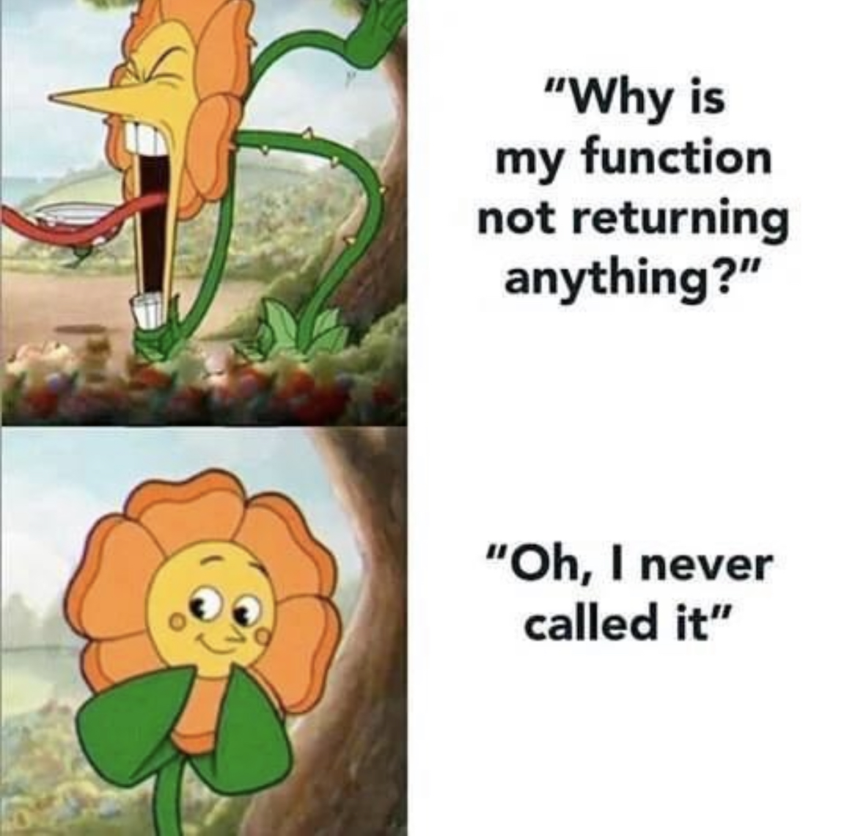
Best Practices for Functions and Classes
Use camelCase for naming functions and variables
Use function expressions instead of declarations
Leave parameter values untouched
Use PascalCase for naming classes and constructors
Use this only in classes or constructors
Return this from methods
Don't assign this to another variable
Get in the practice of returning some type of value when you create new functions. The value returned can tell the calling code useful information about how the function executed.

Slide 37
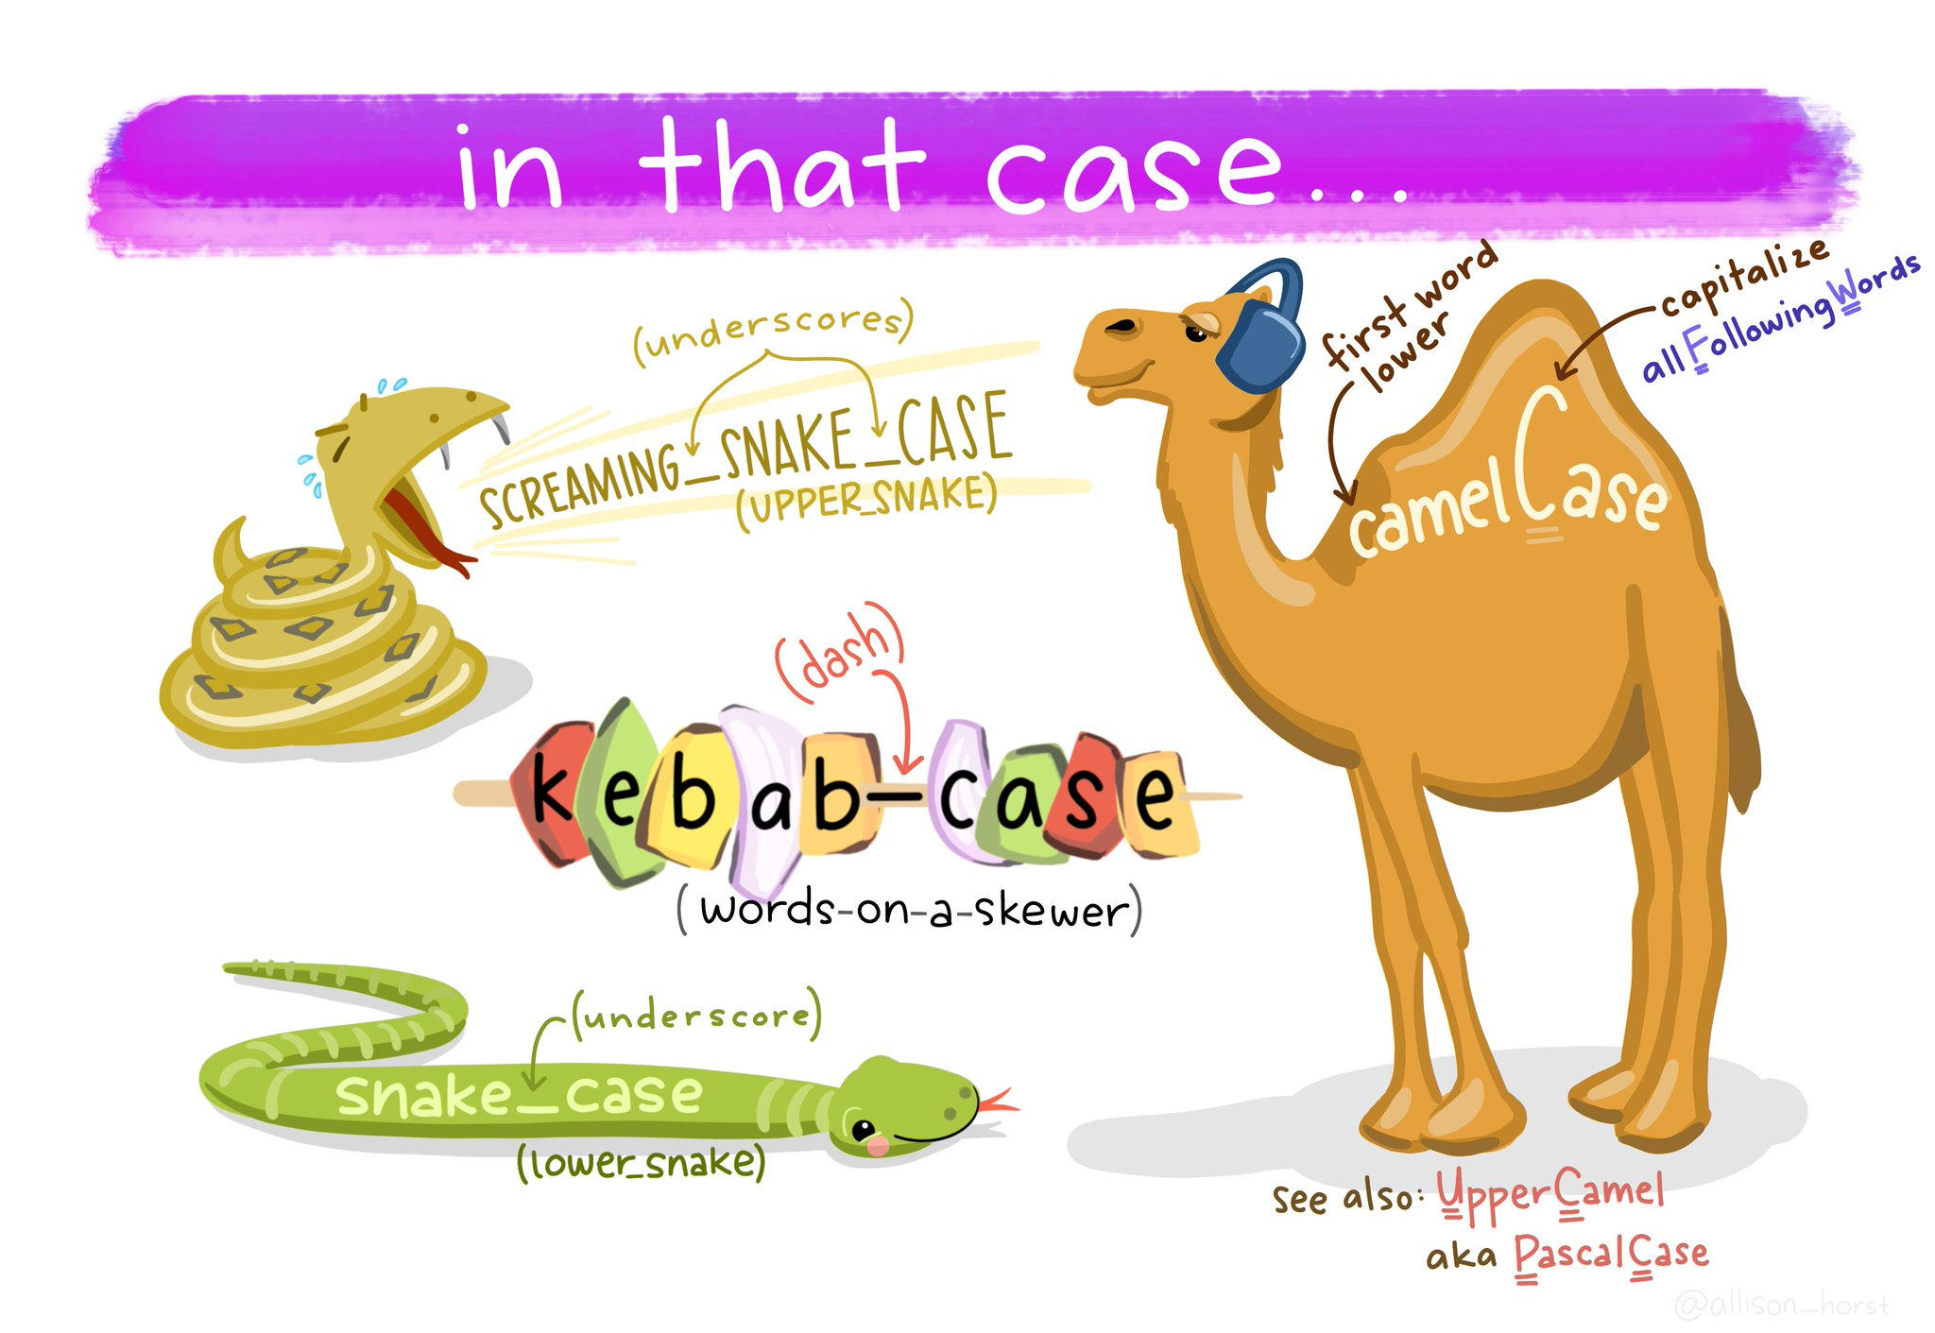

Slide 38
Best Practices for Data Declaring Variables
Meaningful names for functions and variables better indicate to readers the purpose of code.
Use individual statements to create variables
Use camelCase for naming variables
Remove unused variables

Slide 39
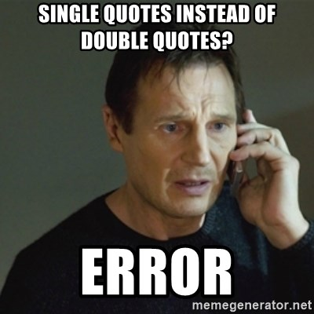
Best Practices for Data Assigning Values
Don't assign variables in chains
Standardize quotes
Create arrays and objects using literals
Quote object property names consistently

Slide 40

Best Practices for Data Type Casting
Type cast strings with the String wrapper
Type cast numbers with the Number wrapper
Type cast Booleans using double negation
Rely on implicit Boolean values in conditionals

Slide 41

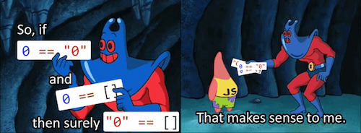
Best Practices for Data Comparing Values
Use triple-character equality operators

Slide 42
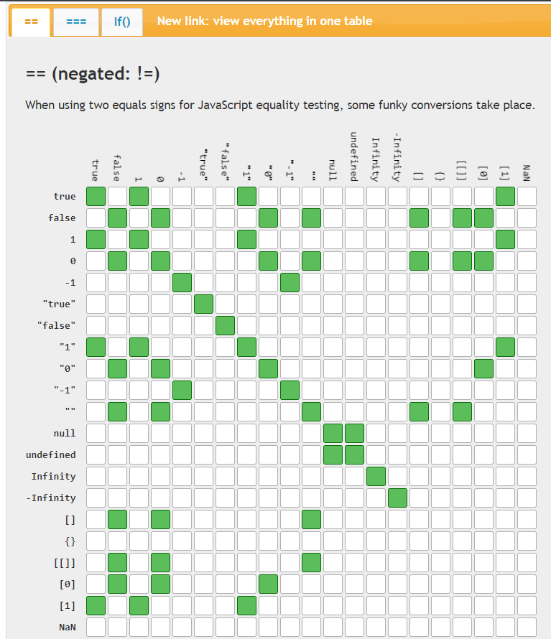
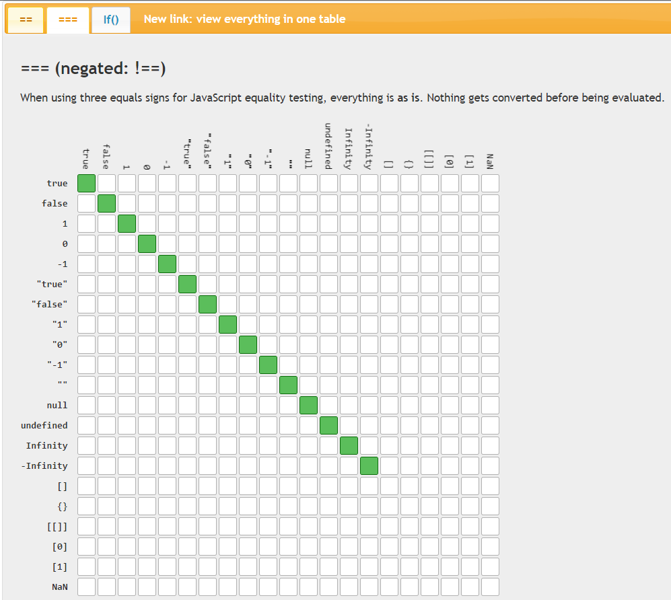
https://dorey.github.io/JavaScript-Equality-Table/

Slide 43
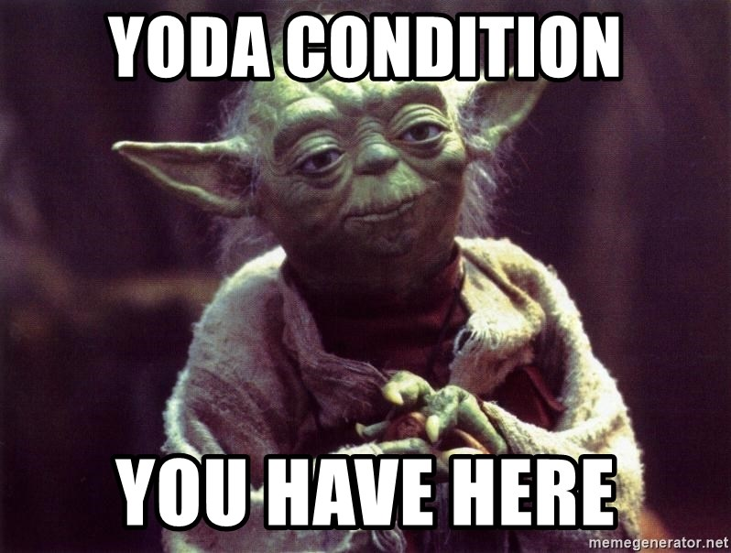
Best Practices for Data Comparing Values
Don't use Yoda conditions

Slide 44

Best Practices for Data Comparing Values
Compare appropriately for the data type
Use ternary statements judiciously
Add parentheses to clarify logic
To avoid unpredictable results and warning messages, verify that variables and fields have a value before using them.

Slide 45
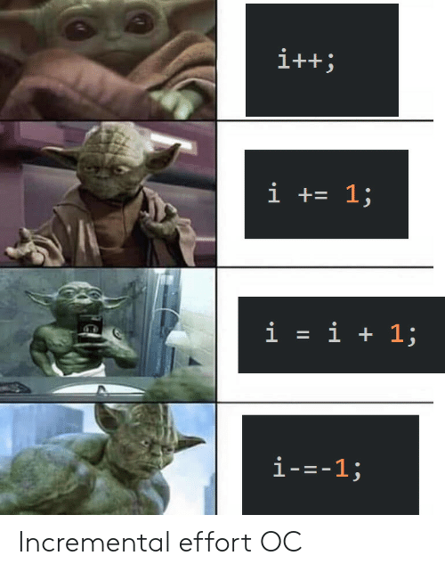
Scripting Best Practices
Avoid unary increments and decrements

Slide 46
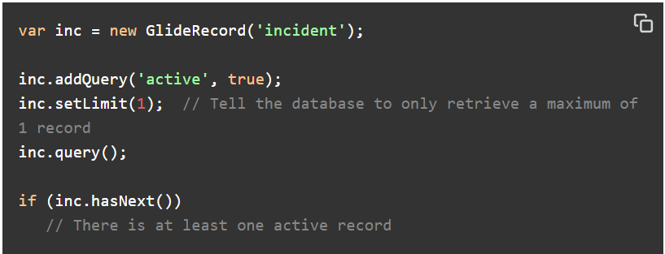
Scripting Best Practices https://beingfluid.in/You-Dont-Know-SN-APIs/glideaggregate.html
Use addEncodedQuery() to make the query easier to create and maintain.
Use GlideAggregate for Simple Record Counting
Whenever possible, leverage the power of the database to retrieve the proper records.

Slide 47
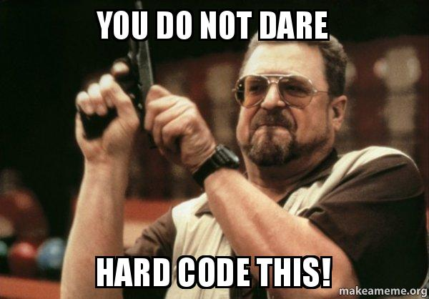
Scripting Best Practices Do Not Use Hard-Coded Values
Avoid using hard-coded values in scripts, as they can lead to unpredictable results and can be difficult to track down later.
Hard coding sys_ids is not recommended, as they may not be the same between instances.
Instead, try looking up a value by reference or by creating a property and retrieving the value with gs.getProperty().

Slide 48

Scripting Best Practices
Avoid Dot-Walking to the sys_id of a Reference Field
It is not necessary to include the sys_id of a reference field when dot-walking, The value of a reference field is a sys_id.
When scripting, become familiar with the tables and fields you are using.
Instead of using name, number, or other explicit field name used for the display value, use the method getDisplayValue().

Slide 49
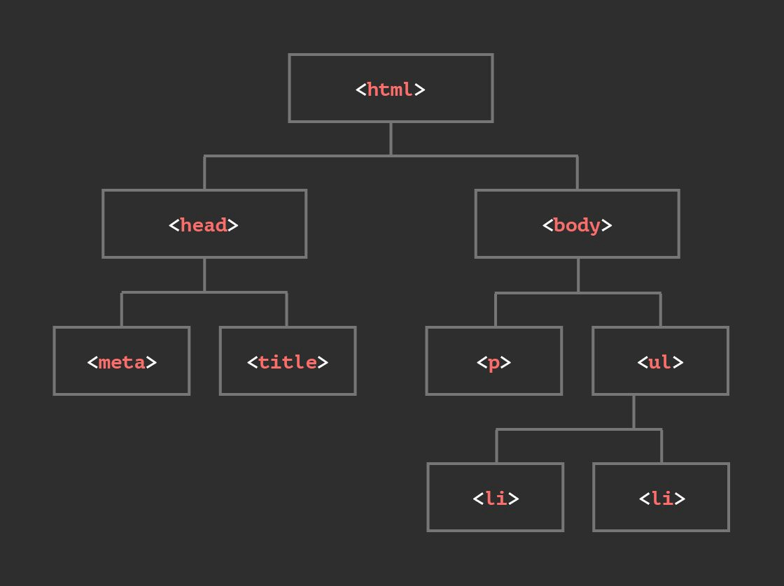
Client Scripting Considerations
An excellent use for Client Scripts is validating input from the user.
Validation improves the user experience because the user finds out if there are data issues before submitting the information.
Set Client Script Order
When possible, consider using a UI Policy to set field attributes to mandatory, read-only, or visible.
If you create UI policies or Client Scripts for fields on a form, you must use another method to ensure that data in those fields is similarly controlled in a list.
Avoid DOM Manipulation

Slide 50
Run Only Necessary Client Scripts
Client Scripts have no Condition field.
This means onLoad() and onChange() scripts run in their entirety every time the appropriate form is loaded.
To avoid running time-consuming scripts unnecessarily, make sure Client Scripts perform only necessary tasks.
Keep the isLoading Check (onChange Client Scripts Only)
Keep the newValue Check
Add the newValue != oldValue Check
When code is not enclosed in a function, variables and other objects are available and shared to all other client-side scripts.
If you're using the same variable names, it is possible they could collide.
This can lead to unexpected consequences that are difficult to troubleshoot.
Avoid Global Client Scripts

Slide 51
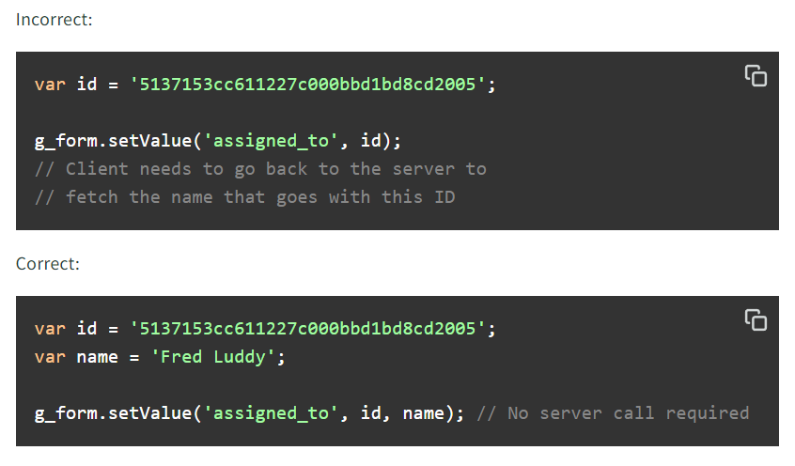
Client Scripting Considerations Minimize Server Lookups
Client scripting uses either data available on the client or data retrieved from the server.
Use client data as much as possible to eliminate the need for time-consuming server lookups.
The top ways to get information from the server are g_scratchpad, and asynchronous GlideAjax lookup.
When using setValue() on a reference field, be sure to include the display value with the value (sys_id).

Slide 52
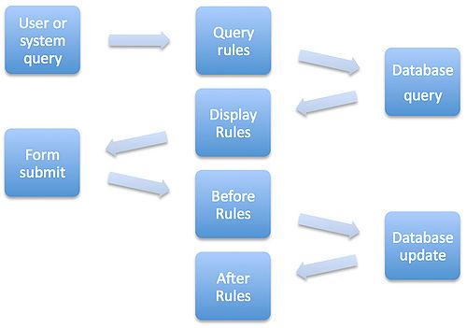
Business Rules Best Practices
Know When to Run Business Rules
Use an async Business Rule in place of an after Business Rule, wherever possible.
Use Conditions in Business Rules
Keep Code in Functions
Avoid using a variable called gr at all
Do not use current.update() in a Business Rule script.
The combination of the update() and setWorkflow() methods is only recommended in special circumstances.
Use Business Rules to Double-Check Critical Input
Use Script Includes Instead of Global Business Rules

Slide 53
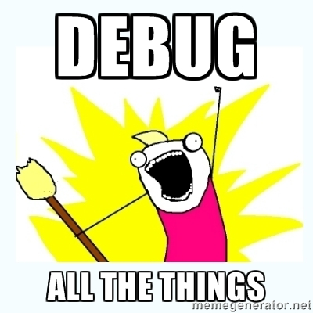
Debugging Best Practices
gs.print() and gs.log() are older and not available in scoped applications, whereas gs.debug(), gs.info(), gs.warn(), gs.error() work in both scoped applications and global
Log Messages Controlled by a Property
Along with useful system information, you may choose to include jslog() statements in client scripts and UI policy scripts to help isolate and resolve issues.
Before you close out an update set or complete testing of the production instance, be sure to disable all server-side debugging to save log space in production.
To disable debugging, search for all system properties that contain the string debug in the name and ensure they are all set to false.
Each error should either be corrected or documented as a known issue.
Remove Unused Events

Slide 54
S.O.L.I.D. Programming Principles https://dev.to/josuerodriguez98/series/12235
S - Single Responsibility Principle
O - The Open/Closed Design Principle
L - Liskov Substitution Principle
I - Interface Segregation Principle
D - Dependency Inversion Principle

Slide 55
Interface Segregation Principle
A client should never be forced to implement an interface that it does not use, or clients shouldn't be forced to depend on methods they do not use.
The objective behind this principle is to remove unnecessary code from Classes in order to reduce unexpected bugs when the Class does not have the ability to perform an action.
Imagine we have a streaming platform that has two types of user, a FreeUser and a PremiumUser, both extending from User.
Taking into consideration that only a PremiumUser is able to skip ads and start parties, to apply the principle, we may use composition to only give these functionalities to PremiumUser.
Now every class is implementing only the functionalities that they need, adhering to the principle.

Slide 56
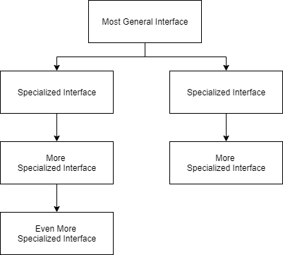
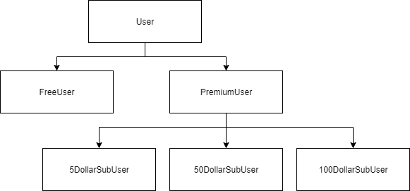
Interface Segregation Principle
Following our FreeUser and PremiumUser example, we may have these inheritances, each one of them adding specific functionalities depending on the subscription type.
To apply this principle to other programming languages, we may use something I like to call "cascading specialization" in which we start on the most general specialization and then, on each level of the inheritance, we add specific actions that the interface needs. The following diagram shows this idea.

Slide 57
Liskov Substitution Principle
A parent class should be substitutable for its child class without any problem.
Every subclass should be able to replace it’s superclass.
This is because in inheritance, the child class should be able to do everything the parent class can do, delivering the same or even improved results.
The principle also implies that the child class's methods should have the same amount of arguments and the arguments type and return type should be of the same type of the parent class that they override.
The objective behind this principle is to strengthen consistency so that parent and children classes can be used in the same way without any errors.

Slide 58
Liskov Substitution Principle
Imagine we have a parent class Animal and it has two children, Dog and Cat.
Each animal has its unique sound, dogs can bark and cats can meow.
Now, if we were to substitute the parent class with the corresponding children, we will create a more generic method for the animal sounds instead of specific methods for each animal sound.
And also, we will make sure that every method returns the same type.

Slide 59
The Open/Closed Design Principle
Classes must remain open for extension but closed for modification.
This means that if we want to add more functionality to a class we should do it by extending the behavior of the class without actually changing the class itself.
The objective of this principle is to avoid modifications that may lead to bugs where the class is being used.
It is aligned closely with ISP and LSP.
ISP segregates the interfaces: Keeps a class closed for further modification
LSP assures that subclass are extensions of a superclass: Creates classes that will be open for extension.

Slide 60
The Open/Closed Design Principle
Let's imagine that we are developing a Checkout functionality for a store that offers discounts to Senior clients and Pregnant clients.
Let's say that we want to add the Veteran type of client.
To adhere to the principle, we may split every type of client into a class and handle the checkout calculation by abstraction.
By splitting each client type into different classes, we don't need to touch the Checkout class again.
If we wanted to add another client type we would only need to create it as a new class and pass it to the getTotalToPay function.

Slide 61
Dependency Inversion Principle
High-level modules should not depend on low-level modules. Both should depend on abstraction.
When we talk about high-level modules we are referring to a class that executes an action implementing a tool or library, and when we talk about low-level modules we are referring to the tools or libraries that are needed to execute an action.
The principle allows for decoupling, which means to separate, disengage or dissociate something from something else.
This helps us by reducing dependency and allowing for easier implementations of other tools in the future.
Avoid depending on concrete class names.
Code that depends on concrete class names is difficult to change.
Any extension which creates a new concrete class causes ripples in the form of rewrites to all the software that depends on the old concrete class.
When depending on abstractions, a new concrete implementation is not disruptive.

Slide 62
Dependency Inversion Principle
Let's imagine that we have a Candy Store and we are developing the checkout process. In the beginning, we only planned to implement Stripe as our payments processor.
Stripe needs for the amount to be passed on as cents to make the transaction.
The Checkout should not care about which payment processor is being used, it only cares about making a transaction.
To decouple these two modules, we would have to implement an intermediary between the checkout and the payment processor, creating an abstraction so that no matter what payment processor we use, the Checkout class will always work with the same method calls.
The new PaymentProcessor class will be in charge of adapting everything to payment processor to be used (in this case, Stripe).
We adapted the intermediary class PaymentProcessor to the processor needs.
We removed the dependency between Checkout and the processor used by implementing the intermediary class PaymentProcessor
Now, if we ever need to change our payment processor, we can do so by passing the new processor instead of Stripe to the PaymentProcessor constructor. Then, we pass the PaymentProcessor to the Checkout.
Imagine that now we are asked to replace Stripe with another payment processor that does not require for the amount to be converted to cents but on every transaction asks for the currency that's going to be used.

Slide 63
Single Responsibility Principle
A class should have one and only one reason to change.
A class should have responsibility over a single part of the functionality provided by the software, and that responsibility should be entirely encapsulated by the class.
The reason behind this principle is to separate responsibilities or behaviors so that debugging and refactoring shouldn't cause problems to other parts of a project.
A good way to see if a class adheres to this principle is to say out loud the responsibilities the class has and be on the lookout for and's. Every and should go on a separate class.

Slide 64
Single Responsibility Principle
Let's say we have an Employee Management class that's responsible for basic CRUD operations over Employees and Logging the results on the console.
In this class, we have a function that pushes employees to an array and a function to log the result of the operation.
Suppose that you're asked to apply the following changes to the code:
Add a validation so that the employee's name isn't empty.
Log operations results into a file and not the console.
Validating that the employee's name is not empty is still a behavior expected from an Employee Management class.
The reason to change was to improve the creation of employees.

Slide 65
Single Responsibility Principle
Logging the result of the operation into a file is not a behavior related to Employees Management.
To apply the principle, we should have the logResult function on a separate Logger class so that if we ever want to change the way we log the results, it should be on its own, separate class.
Remember that we want each class to have one and only one reason to change. With the new code, if we want to change the way we add an employee or the way we log the results of an operation we can do so in their own, separate classes, following the Single Responsibility Principle.

Slide 66
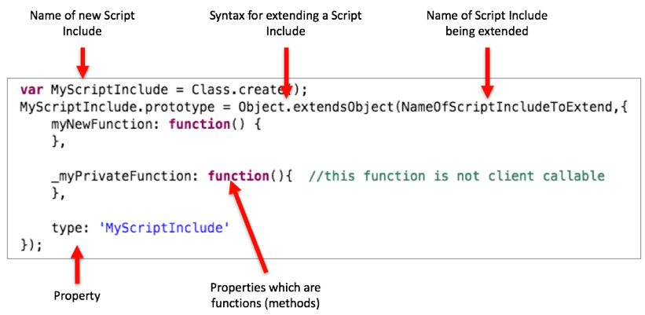
Extend the OOTB Script Includes
Avoid modifications to the OOTB Script Include code
In order to improve the functionality extend the script include and override the function (or create new one)
When creating new Script Includes, make sure it has a single responsibility

Slide 67
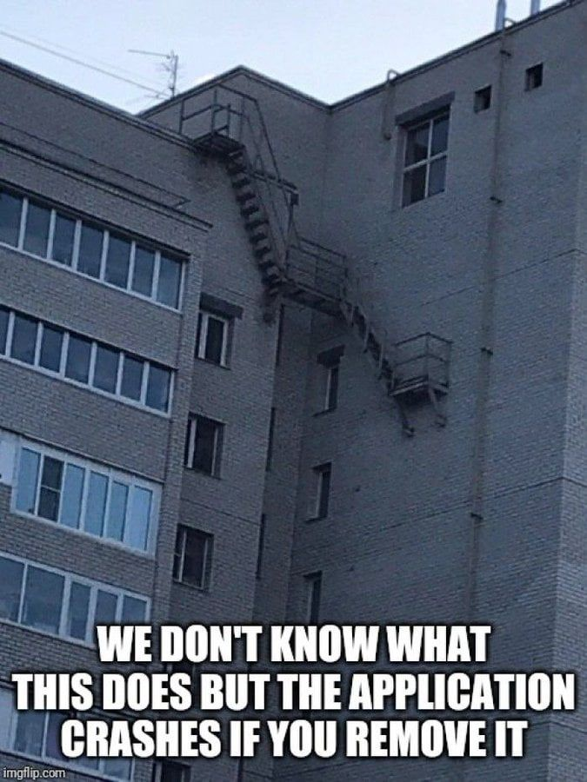
Dealing with Legacy Code and Technical Debt
Some features could/will be deprecated or code can be made better with new & alternative feature.
Understand the code
Look for documentations
Your have the power to make it better
Look for performance optimizations.

Slide 68

Technical Debt Grows like Weeds
Removing weeds is not on-time activity
Eventually weeds will grow back
Weeds sprout slowly over time
Best to spend time weeding every day

Slide 69
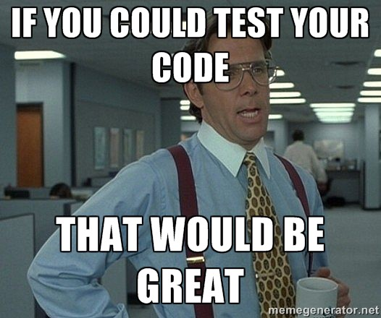
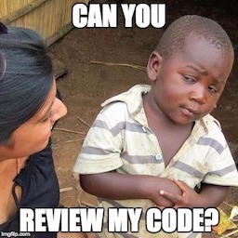
Code without unit tests is a hazard.

Slide 70


